Slide 1
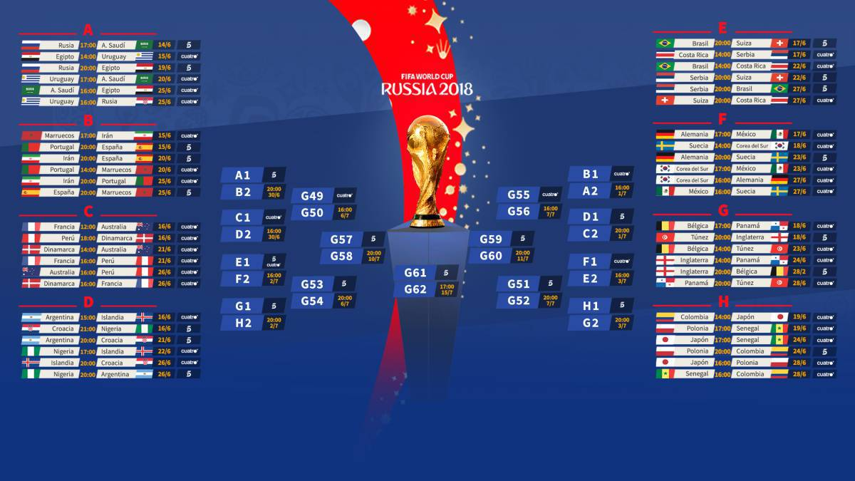
Who will be the Next Champion?
Building a Relational Database for FIFA World Cup in SQL

Slide 2
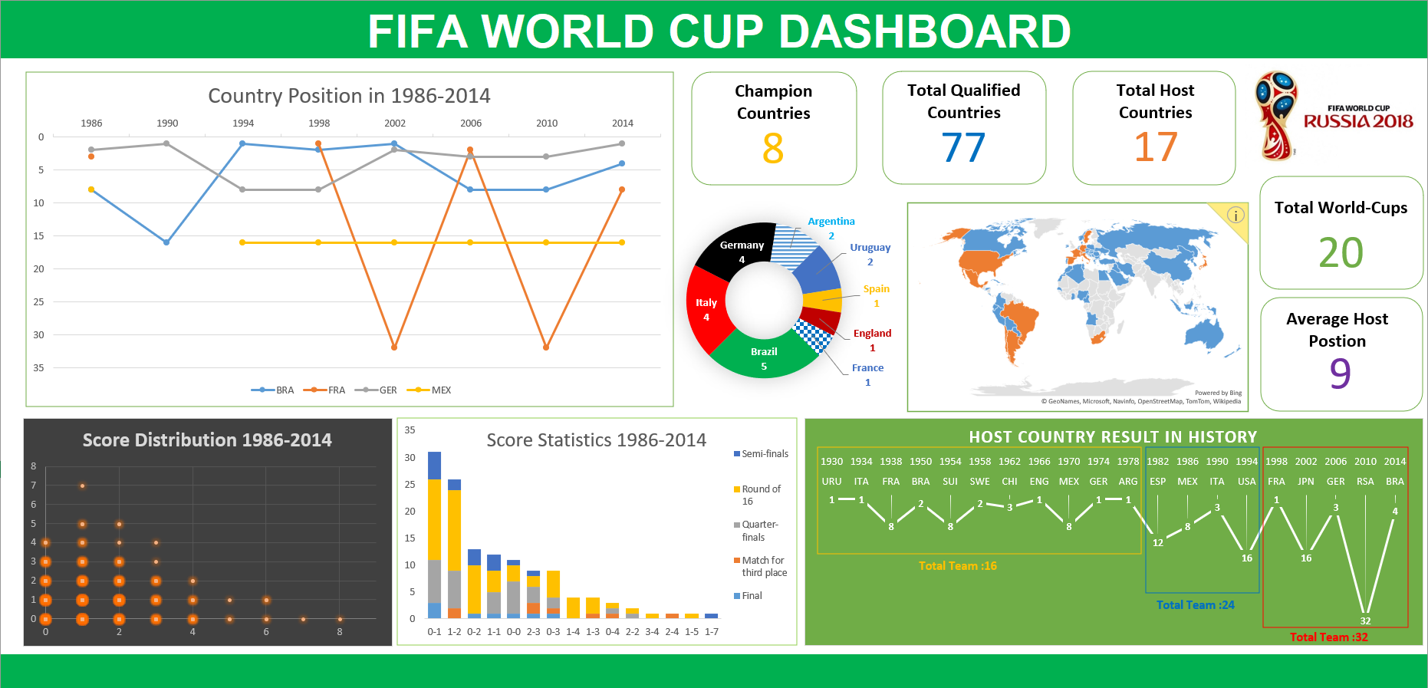
Dashboard Overview

Slide 3
Table of Content
Content
Problem Definition
Data Collection
E-R Diagram & Schema
Data Preparation
Data Analysis
Data Visualization & Insights
Q & A

Slide 4
Problem Definition
Problem Definition
A Real Scenario:
Earlier in June 2018, since FIFA World Cup 2018 was getting closer, most of my friends decided to watch the games together or even make some bets (or buying Singapore Pools) on the result. I was also interested in it and would like to participate.
But the Problem was that I had only very basic common sense about World-Cup and totally no idea about the performance of each country or how was the score like in usual. Which made me unable to catch up the chat with my friends. (or lose the bet)
Luckily, the historical World-Cup records are well kept and easy to assess. Analysis could be carried out based on these previous records in order to get the insights which might be useful to me.
So, My Solution was to look for the World-Cup’s track record and try to figure out at least the following insights:
Quick Facts about World Cup;
What are the Top Teams;
What are the Dark Horses;
What are the Common Scores;
…

Slide 5

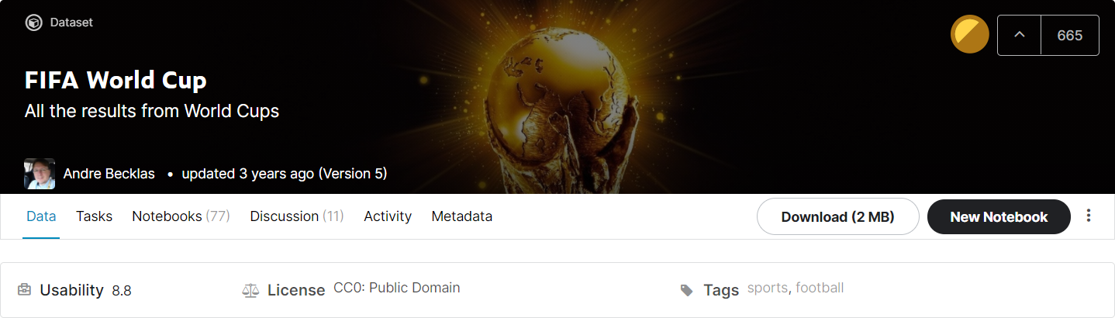
Data Collection
Data Collection
Sources:
Kaggle - FIFA World Cup-All the results from World Cups : https://www.kaggle.com/abecklas/fifa-world-cup

Slide 6
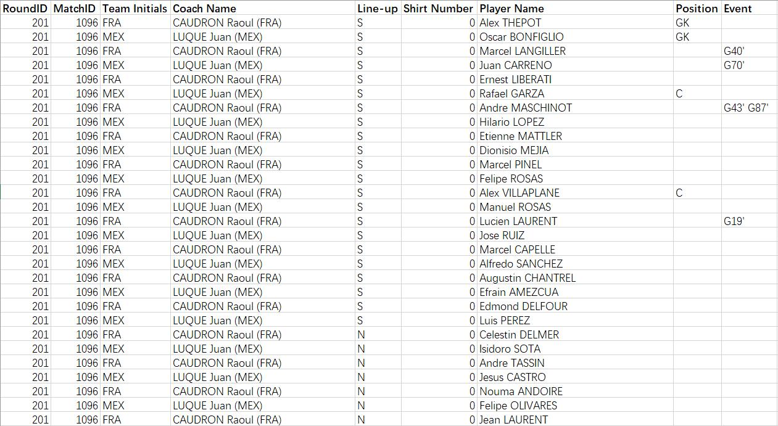
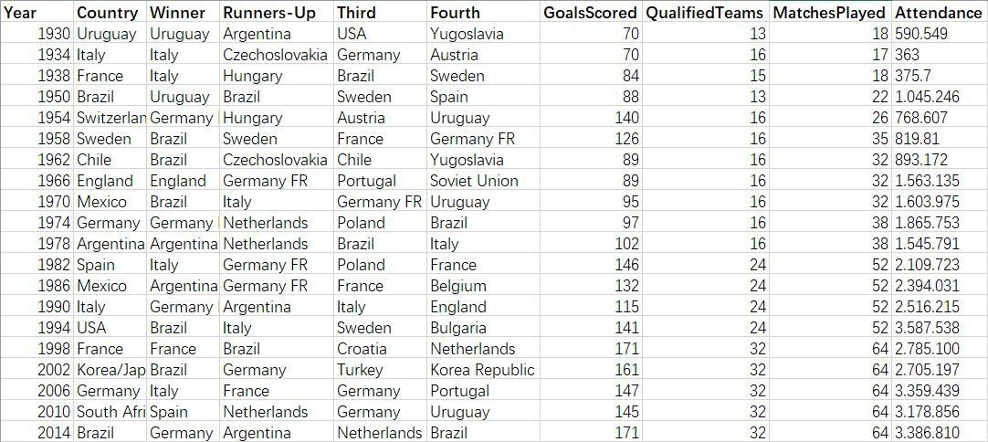
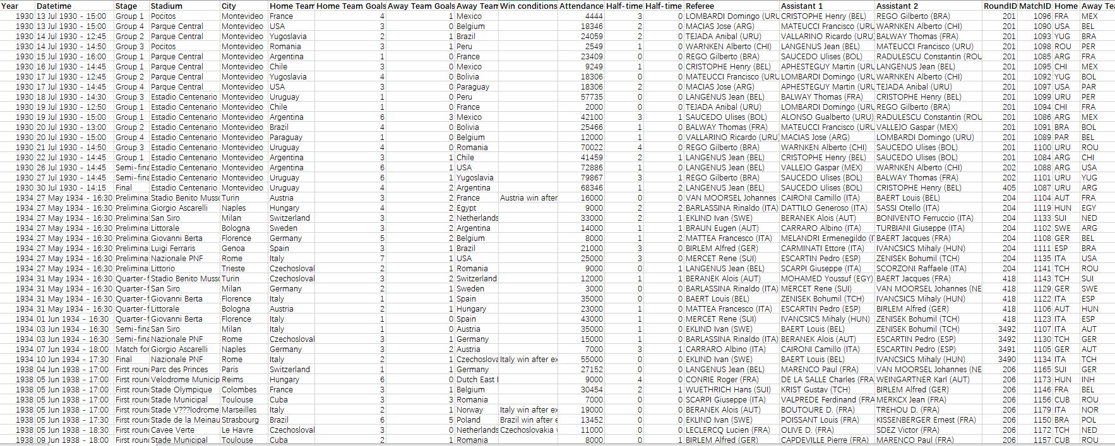

Data Collection
FIFA World Cup-All the results from World Cups
Files:
Attribute:10
Row:20
Attribute:20
Row:852
Attribute:9
Row:37,784
Merits:
Intact dataset providing all the information in need.
Demerits:
1.Tables are too bulky to handle;
2.Repeating long values occupying extra storage space;(e.g. All kinds of Name);
3.Foreign alphabets displaying as ‘???’;
4.Duplicate records;

Slide 7
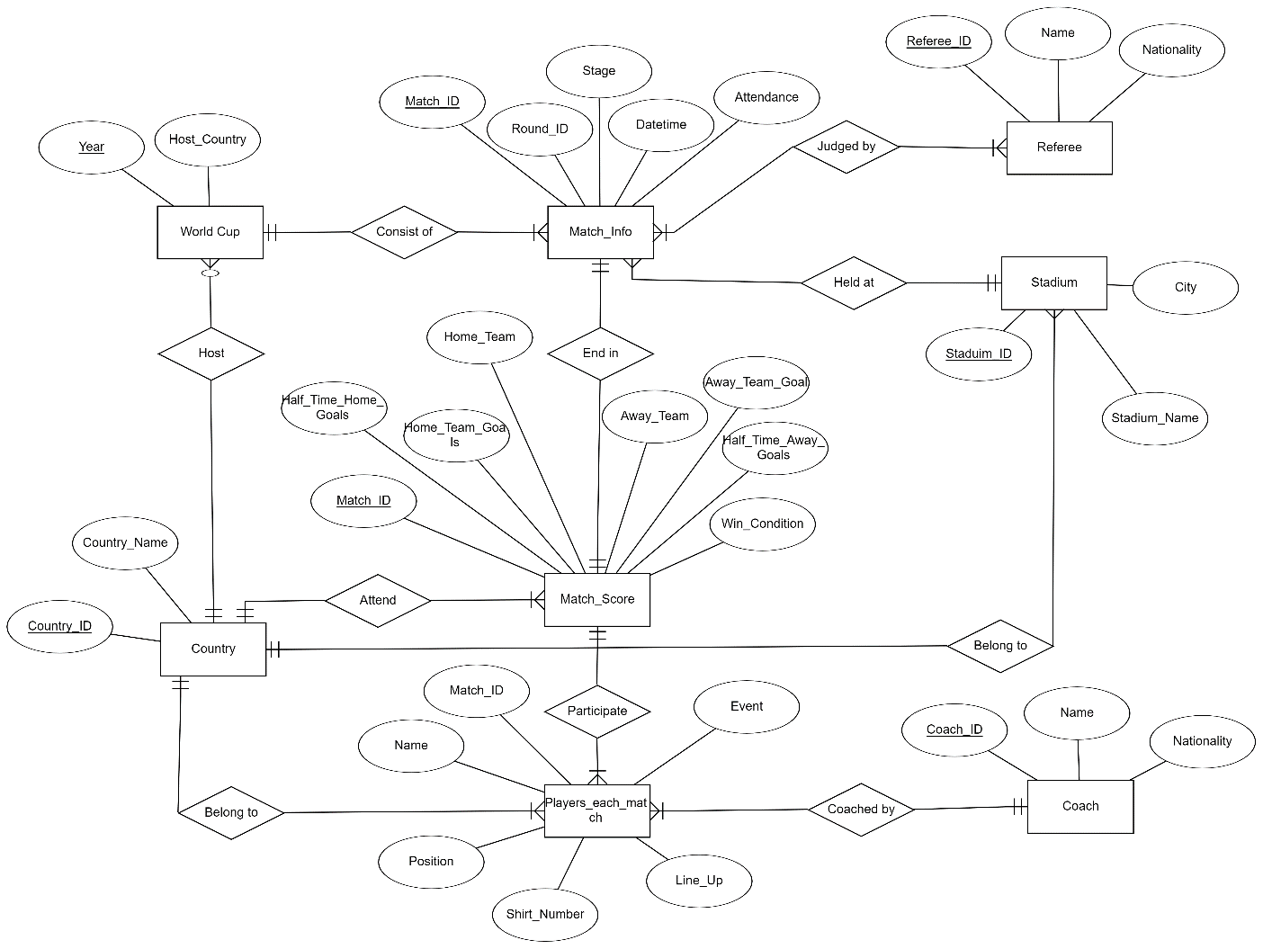
E-R Diagram
Entity
1.Country
2.World Cup
3.Match Info
4.Match Score
5.Referee
6.Stadium
7.Players each match
8.Coach

Slide 8
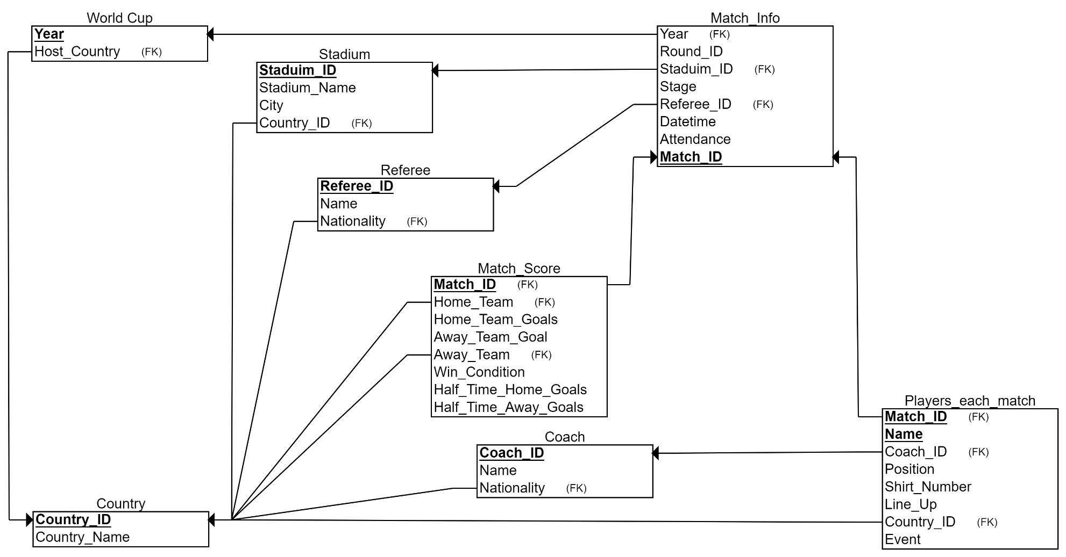
Schema
Table
Creating
Sequence
1.Country
2.World Cup
3.Stadium
4.Referee
5.Coach
6.Match Info
7.Match Score
8.Players each
match

Slide 9
Schema
Creating Tables Based on Schema

Slide 10
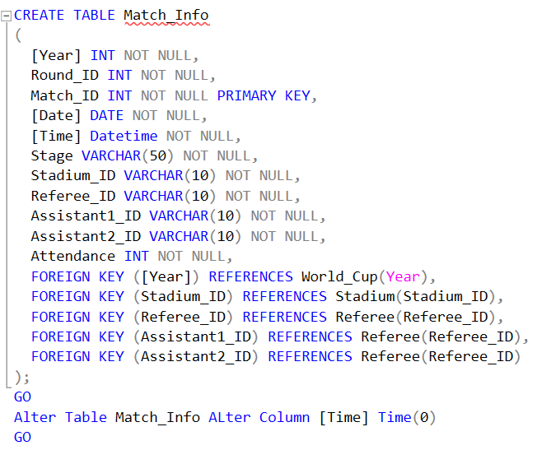
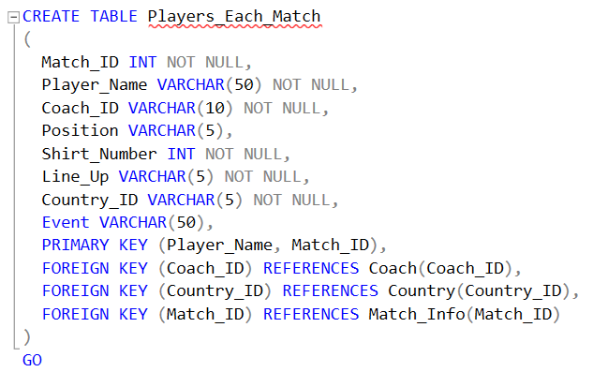
Schema
Creating Tables Based on Schema in SQL

Slide 11
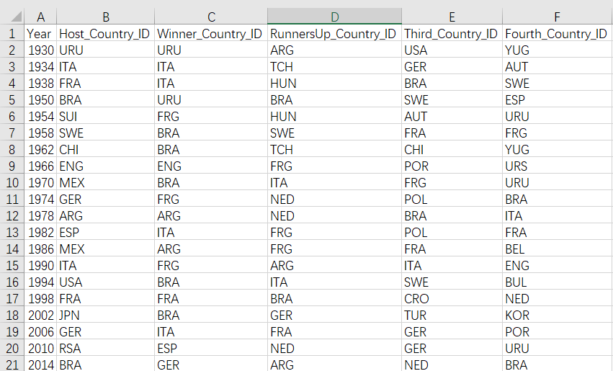
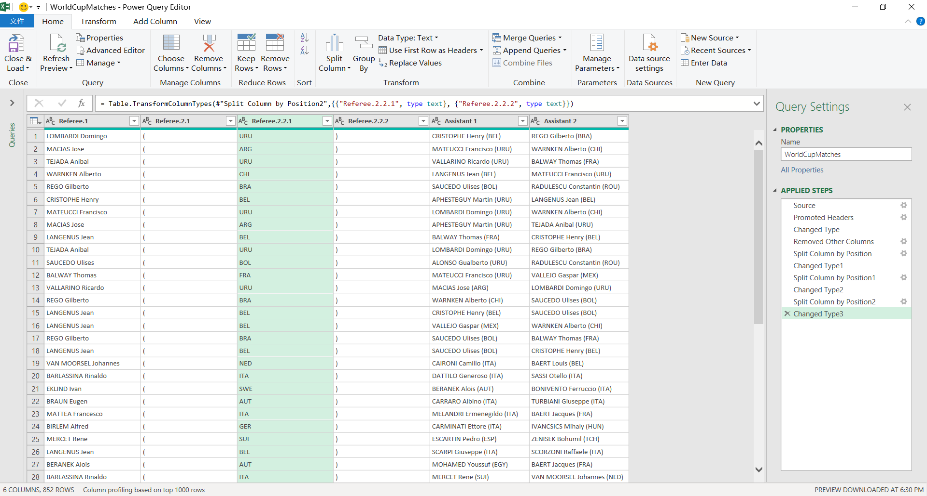
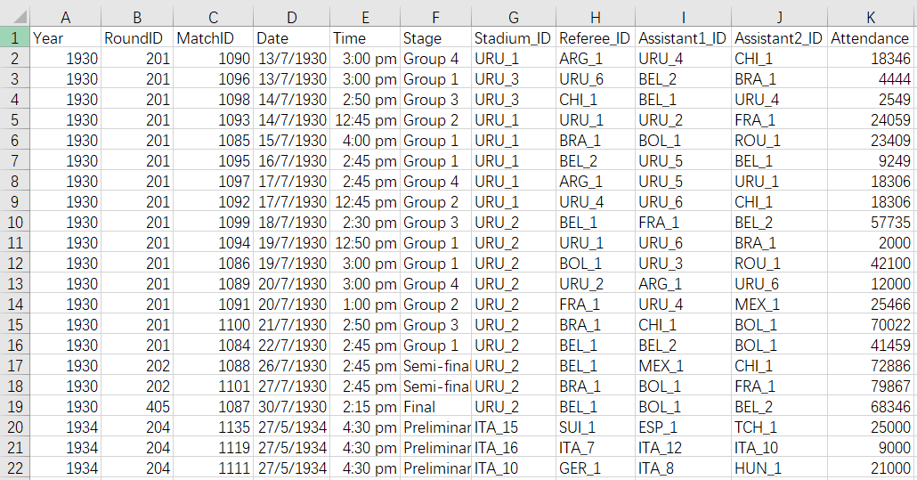
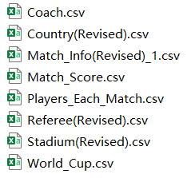
Data Preparation
Data Transformation – e.g. Split Tables by Power Query

Slide 12
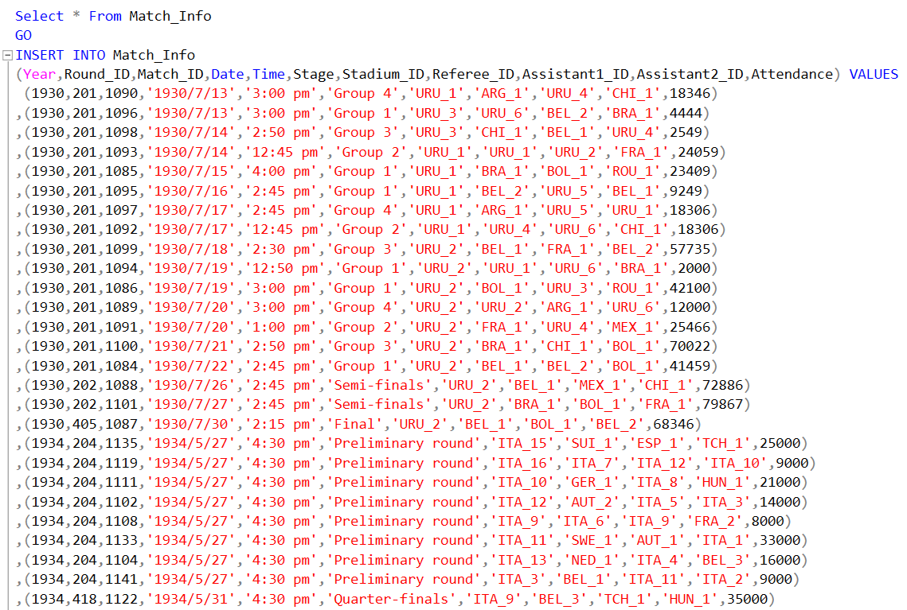
Data Preparation
Loading Data into SQL Database

Slide 13
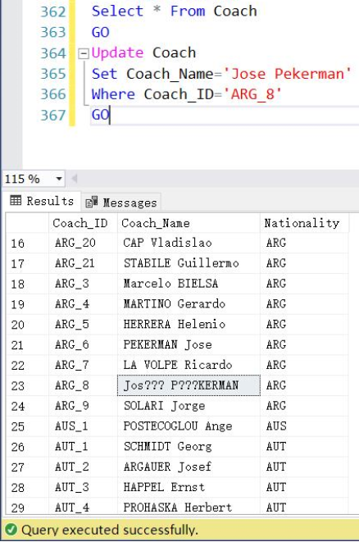
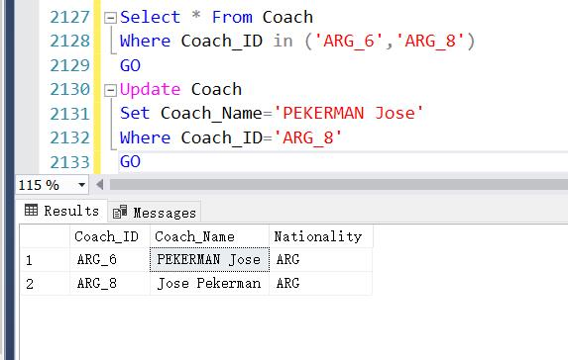
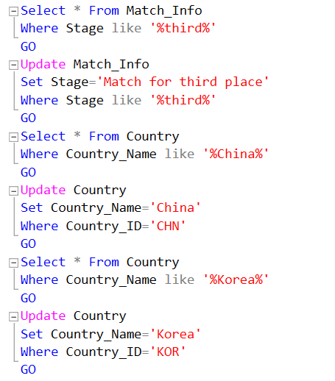
Data Preparation
Data Cleaning in SQL
Remove anomalies and outliers
Remove duplicates
Replace value

Slide 14
Data Analysis
Data Analysis
Insights to dig out:
Quick Facts about World Cup;
What are the Top Teams;
What are the Dark Horses;
What are the Common Scores;

Slide 15
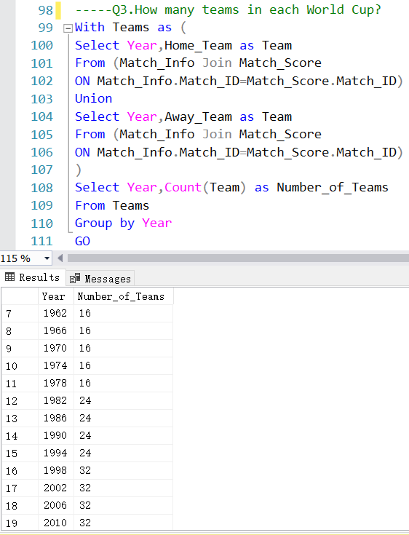
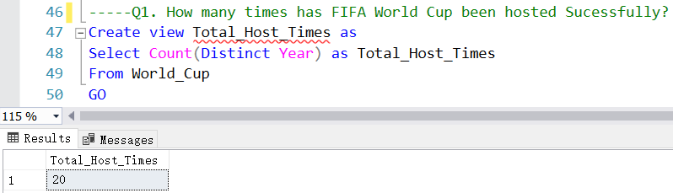
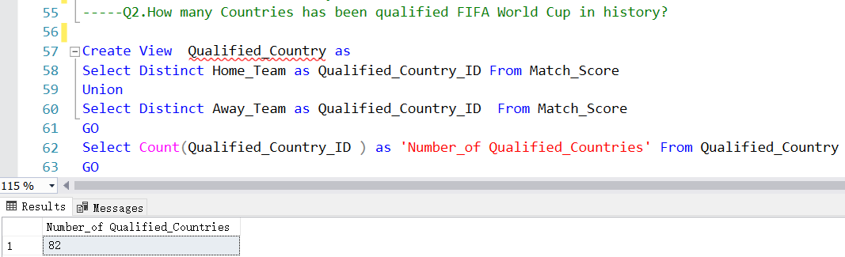
Data Analysis
Data Analysis
Basic Aggregate, Group by, Union, Join Function
Quick Facts about World Cup：

Slide 16
Data Analysis
Data Analysis
Historical Performance of each Country
What are the Top Teams;
What are the Dark Horses:
Different Competition Format in history:
Due to different number of Qualified teams in each World-Cup and other historical issues, the Competition Format has been changed for several times.
(World-Cup 1950 even had no Knockout Games!)
The current format has been put into practice since 1998, Which consists of:
Group Game(32 teams), Round of 16, Quarter-Finals, Semi-Finals, Match for 3rd Place & Final.
For World-Cup 1986-1994,although there were only 24 teams in Group Games, the format for Knockout Games were as same as current format.
So, the range of data has been decided as 1986-2014 to analyze the Historical Performance
Qualified Times
How many times have this Country entered World-Cup?
Average Position
What is the average Ranking of this Country in history?
Top Teams ： High Qualified Times, High Average Position
Dark Horses: Low Qualified Times, High Average Position

Slide 17
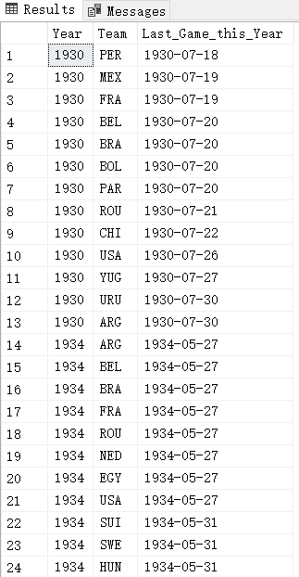
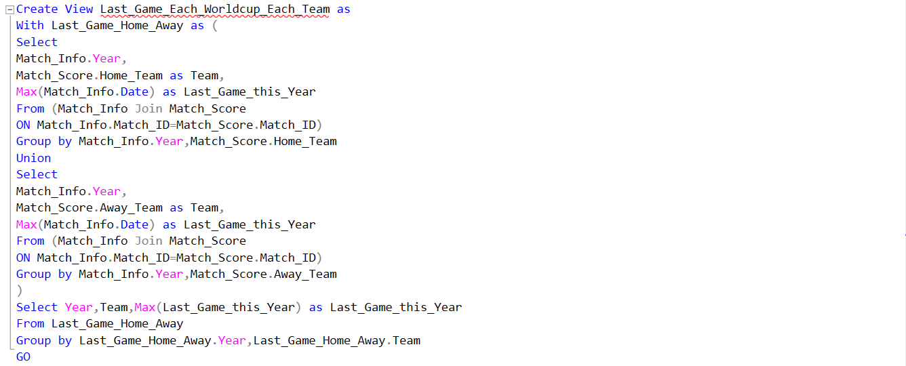
Data Analysis
Data Analysis
How far did every country go in each world cup(1986-2014)?
Create a View to show the Last Game Date for each country in each World-Cup
Select Year, Country, Last Game Date From Home Team
Union Home and Away Team Records
Select Year, Country, Last Game Date From Away Team
Select Year, Country, Last Game Date From Union Records

Slide 18
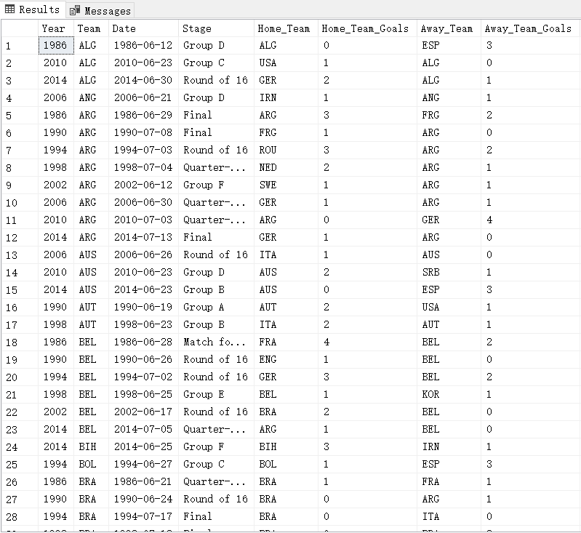
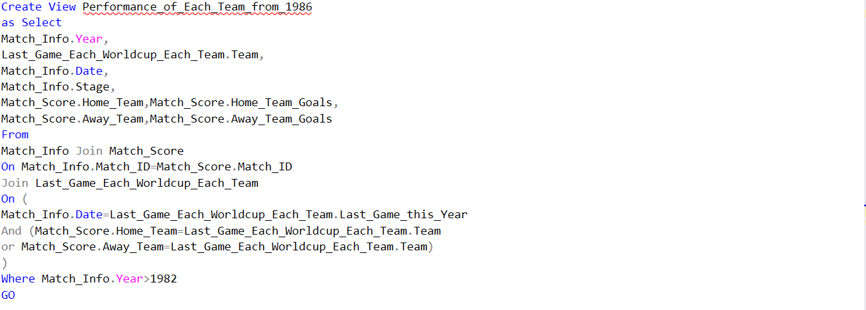
Data Analysis
Data Analysis
How far did every country go in each world cup(1986-2014)?
Create a View to show the Last Game Info(in other words: Best Result) for each country in each World-Cup
Select the necessary information from dbo.Match_Info and dbo.Match_Score
Use Last Game Date & Team from View Last_Game_Each_Worldcup_Each_Team to filter out the Best Result of each country in each world cup
Filter the record by Year

Slide 19
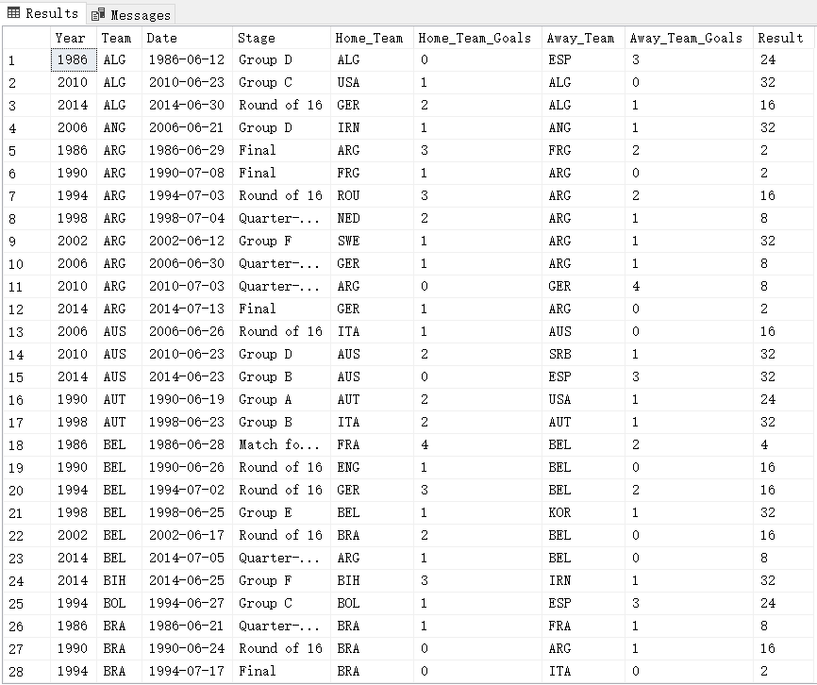
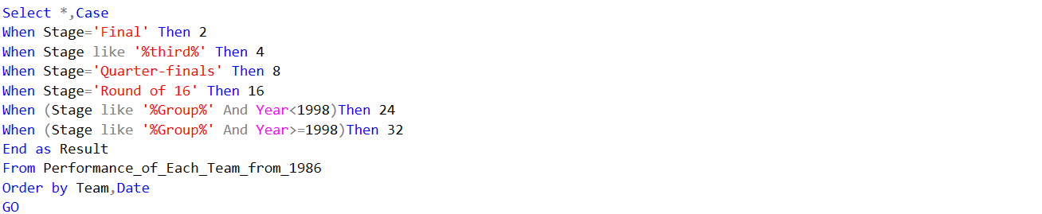
Data Analysis
Data Analysis
How far did every country go in each world cup(1986-2014)?
Categorize the Best Result and convert into Numerical Values

Slide 20
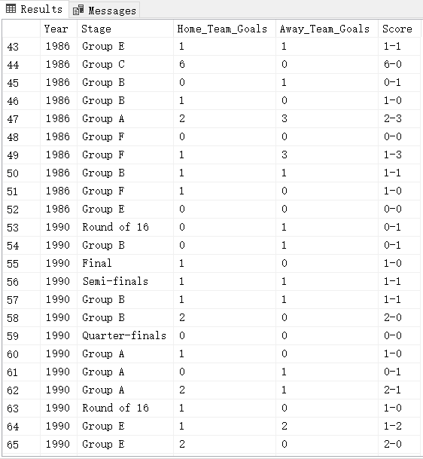
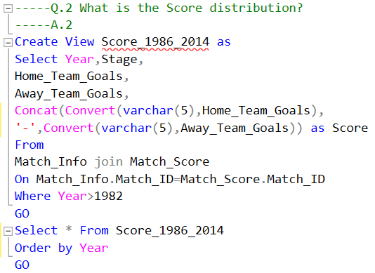
Data Analysis
Data Analysis
Score Distribution
What are the Common Scores;

Slide 21
Data Visualization & Insights
Data Visualization & Insights
Let’s Move to Dashboard

Slide 22

Data Visualization & Insights
Conclusion
Result of World-Cup 2018
Brazil: Position 8
Germany: End in Group Games
Italy: Not even qualified
Argentina: Position 8
Mexico: Still Rank 16…
France :
Top Teams :
Brazil: 5 Champion, Stable high performance
Germany:4 Champion, Stable high performance
Italy: 4 Champion, performance falling downwards
Argentina: 2 Champion, performance uprising
France: 1 Champion, performance uprising
Rank 16 for Continuous 6 World-Cup:
Mexico
Dark Horses:
Turkey(3), Ukraine(8), Senegal(8)
Common Score
0-1,1-2

Slide 23
Data Visualization & Insights
What’s more
Historical competition could be retrieved, and statistics could be carried out if 2 Countries has been provided.
Some of the tables(e.g. Players, Stadium, etc.) and attributes(e.g. attendance, Half time goals etc.) not in use this time could be used for future analysis to dredge more insights
Quantitative Analysis

Slide 24
Q&A
Q & A

Slide 25
Thank you!
Li Zheming

